Slide 1
Black Box Testing State Transition Testing

Slide 2
State Transition Testing
State transition testing is used where some aspect of the system can be described in what is called a 'finite state machine'. This simply means that the system can be in a (finite) number of different states, and the transitions from one state to another are determined by the rules of the 'machine'. This is the model on which the system and the tests are based. Any system where you get a different output for the same input, depending on what has happened before, is a finite state system. A finite state system is often shown as a state diagram

Slide 3
State Transition Testing
A state transition model has four basic parts:
the states that the software may occupy (open/closed or funded/insufficient funds);
the transitions from one state to another (not all transitions are allowed);
the events that cause a transition (closing a file or withdrawing money);
the actions that result from a transition (an error message or being given your cash).

Slide 4
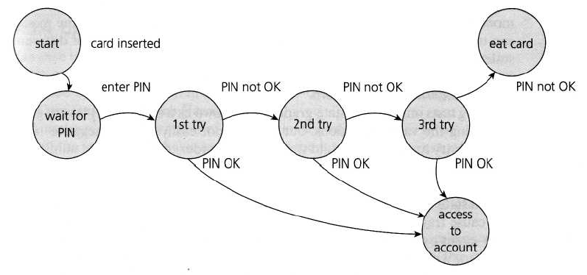
State Transition Testing
State Diagram for PIN Entry

Slide 5
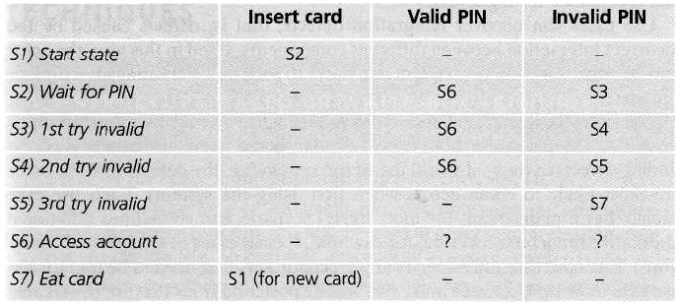
State Transition Testing
State table for the PIN example

